Slide 1
The Determinant of Entrepreneurial Work for Elderly in Indonesia
Sri Subanti, Arif R Hakim, Winita Sulandari

Slide 2
Content
01.
Introduction
02.
Methods
03.
Results & Discussion
04.
Conclusion

Slide 3

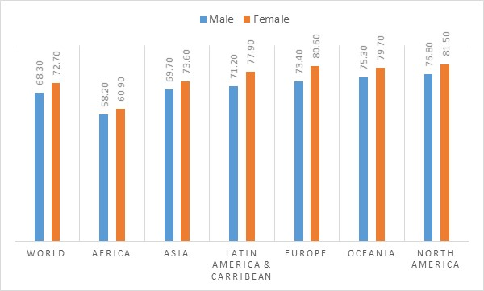
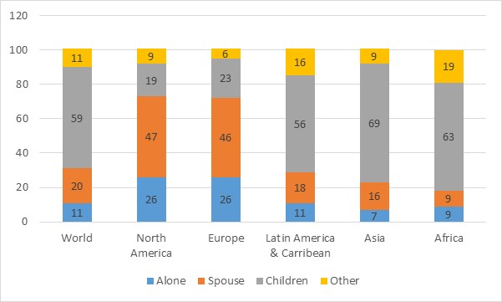
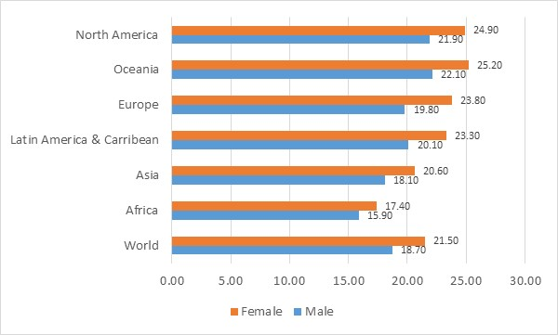
Introduction
Source : UN 2015
Source : UN 2017
Female have a higher life expectancy at birth than male
Female life expectancy’s at age 60 are higher than male
Majority of elderly live with children in Asia, Africa, Latin America - but in Europe & North America, they live with their spouse
Source : UN 2015

Slide 4
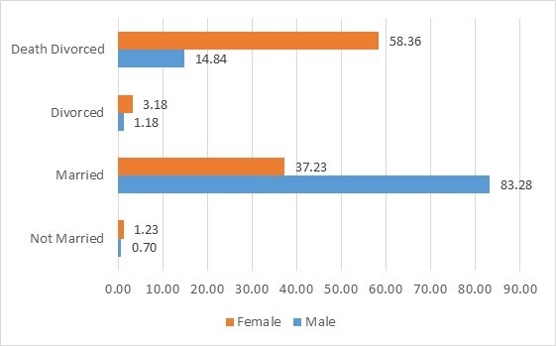
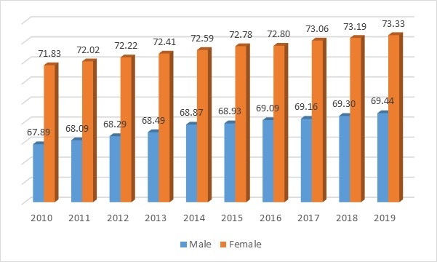
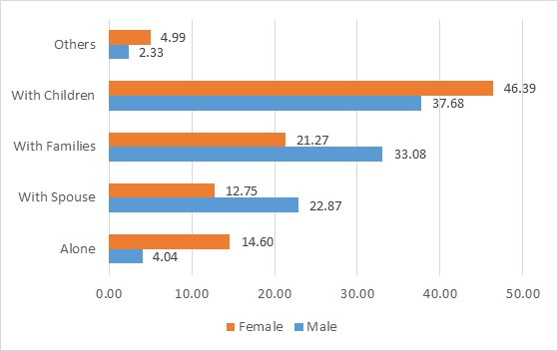
HOW ABOUT INDONESIA
Elderly & Marital Status, 2014
Life Expectancy Based on Gender
Life Expectancy at Birth of Female is Higher than Male
Female can potentially spend the last year of their life without their partner (their spouse)
Both male and female elderly’s need family support, although some of them are forced to live alone
Elderly & Living Together Status, 2014

Slide 5
The employment condition of elderly in Indonesia
The majority of elderly still work
The agricultural sector is chosen by the majority of elderly who are still working
The majority of elderly who work are assited by workers (laborer or employee)

Slide 6
Cont.
Some studies have done in developed countries, it has various findings;
The same studies for developing countries are still rarely
The previous studies also argue that
Becoming elderly entrepreneur increases with age
Besides age, how the role of endowment factor as a determinants of entrepreneurship of elderly
Notes:
Literature address endowment such as the disposable income, assets that can serve as collateral bank loans, social capital, professional and industrial experience, and knowledge

Slide 7
Methods
DATA
APPROACH
Source : Central Bureau of Statistics
The national labor force survey data (well known as Sakernas)
the bias selection model approach from Heckman, where the hours work variable is the dependent variable.
To anticipate the possibility of potential selection bias, which can occur in observed data, the model includes inverse mills ratio as an independent variable into the model.
It will be estimated by the OLS technique through multiple regression

Slide 8
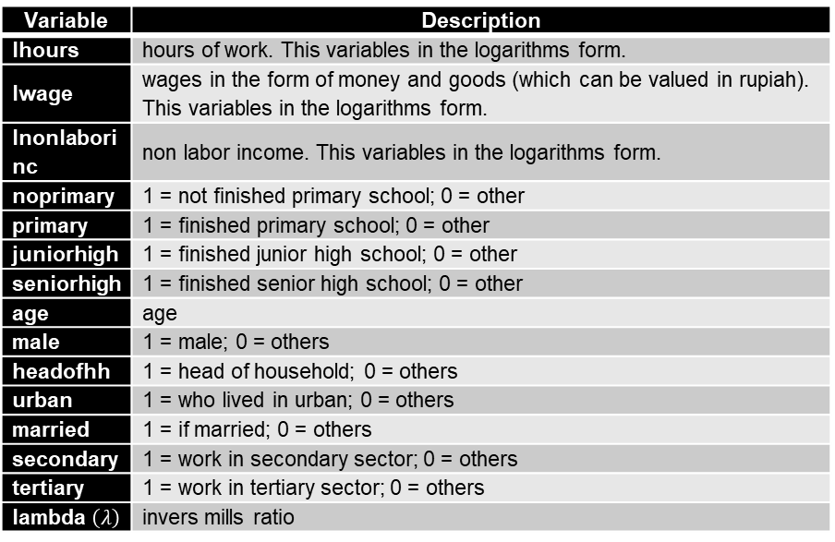
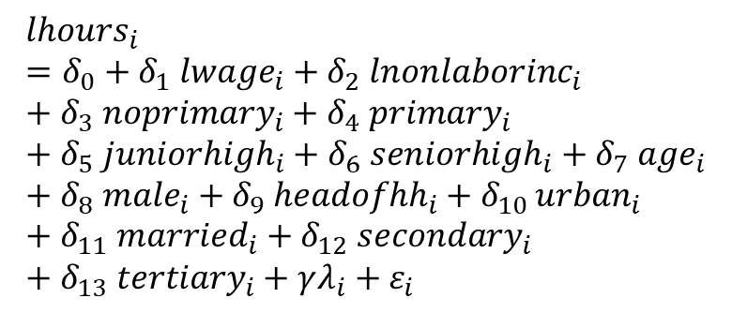
Cont..
Empirical Model
Description of Variable
$${lhours}_{i}=δ_{0}+δ_{1} {lwage}_{i}+δ_{2} {lnonlaborinc}_{i}+δ_{3} {noprimary}_{i}+δ_{4} {primary}_{i}+δ_{5} {juniorhigh}_{i}+δ_{6} {seniorhigh}_{i}+δ_{7} {age}_{i}+δ_{8} {male}_{i}+δ_{9} {headofhh}_{i}+δ_{10 }{urban}_{i}+δ_{11} {married}_{i}+δ_{12} {secondary}_{i}+δ_{13} {tertiary}_{i}+γλ_{i}+ε_{i}$$
Variable | Description
lhours | hours of work. This variables in the logarithms form.
lwage | wages in the form of money and goods (which can be valued in rupiah). This variables in the logarithms form.
lnonlaborinc | non labor income. This variables in the logarithms form.
noprimary | 1 = not finished primary school; 0 = other
primary | 1 = finished primary school; 0 = other
juniorhigh | 1 = finished junior high school; 0 = other
seniorhigh | 1 = finished senior high school; 0 = other
age | age
male | 1 = male; 0 = others
headofhh | 1 = head of household; 0 = others
urban | 1 = who lived in urban; 0 = others
married | 1 = if married; 0 = others
secondary | 1 = work in secondary sector; 0 = others
tertiary | 1 = work in tertiary sector; 0 = others
lambda $\left(λ\right)$ | invers mills ratio

Slide 9
Results & Discussion
TABLE 3. Estimation Results
Dependent | 60 + |  |  | Age 60 - 74 |  |  | Age 75 +
lhours
Independent | Coef. | Std.Err | Sign | Coef. | Std.Err | Sign | Coef. | Std.Err | Sign
lwage | 0.048 | 0.006 | *** | 0.049 | 0.006 | *** | 0.027 | 0.023
lnonlaborincome | 0.016 | 0.006 | *** | 0.014 | 0.007 | ** | 0.018 | 0.019
age | -0.004 | 0.002 | ** | -0.004 | 0.002 | ** | 0.001 | 0.005
male | 0.017 | 0.024 |  | 0.014 | 0.027 |  | -0.051 | 0.046
headofhh | 0.056 | 0.025 | ** | 0.042 | 0.023 | * | 0.213 | 0.151
married | -0.070 | 0.045 |  | -0.055 | 0.047 |  | -0.123 | 0.156
noprimary | 0.140 | 0.023 | *** | 0.142 | 0.024 | *** | 0.176 | 0.121
primary | 0.160 | 0.024 | *** | 0.160 | 0.024 | *** | 0.242 | 0.126 | *
juniorhighschool | 0.124 | 0.033 | *** | 0.133 | 0.032 | *** | -0.089 | 0.332
seniorhighschool | 0.070 | 0.047 |  | 0.078 | 0.048 | * | 0.191 | 0.262
urban | 0.064 | 0.016 | *** | 0.056 | 0.018 | *** | 0.142 | 0.037 | ***
secondary | 0.177 | 0.070 | *** | 0.150 | 0.075 | ** | 0.266 | 0.139 | **
tertiary | 0.214 | 0.054 | *** | 0.194 | 0.056 | *** | 0.288 | 0.170 | .*
lambda | 0.196 | 0.170 |  | 0.139 | 0.182 |  | 0.367 | 0.381
cons | 2.733 | 0.154 | *** | 2.848 | 0.167 | *** | 2.344 | 0.694 | ***
Num of Obs |  | 5334 |  |  | 5057 |  |  | 277
F - Stat |  | 44.100 |  |  | 40.970 |  |  | 6.810
Prob F - Stat |  | 0.000 |  |  | 0.000 |  |  | 0.000
R - Squared |  | 0.113 |  |  | 0.111 |  |  | 0.208

Slide 10
CONCLUSION
The economic factors (such as salaries and labor income) as well as employment and other demographic variables affect the allocation of working hours for elderly
The government must be interested in helping the elderly who still want to be working.
The elderly need to be supported by a good support system, so they can contribute in their roles and activities to the community while they are still healthy and active.

Slide 11
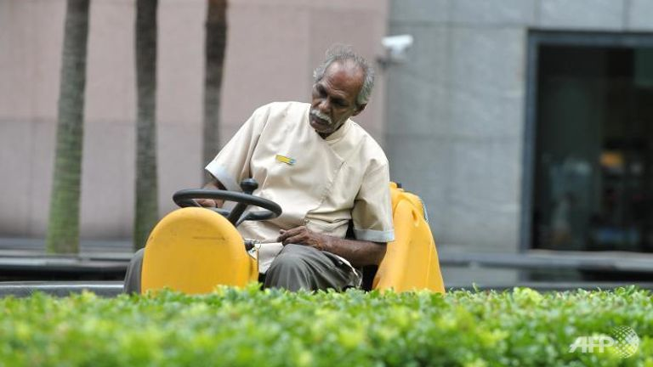
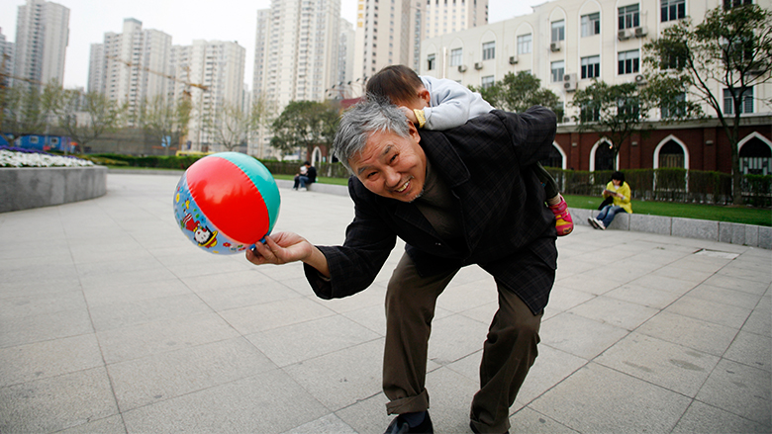
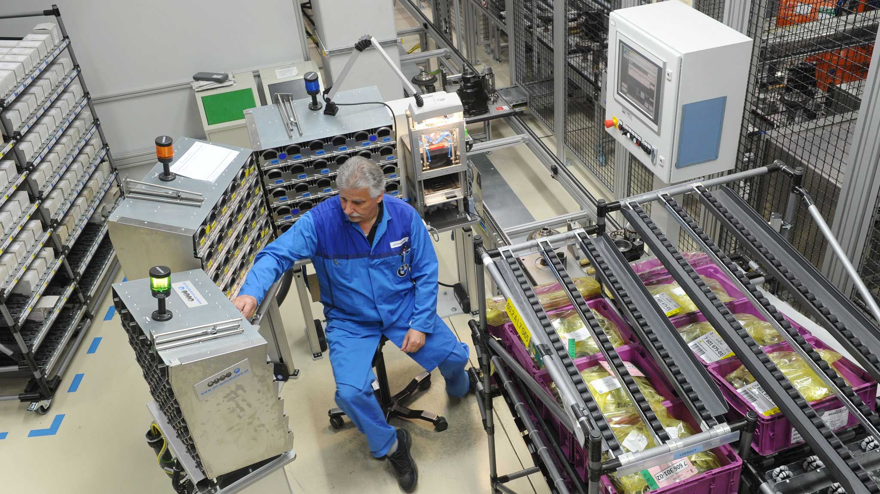
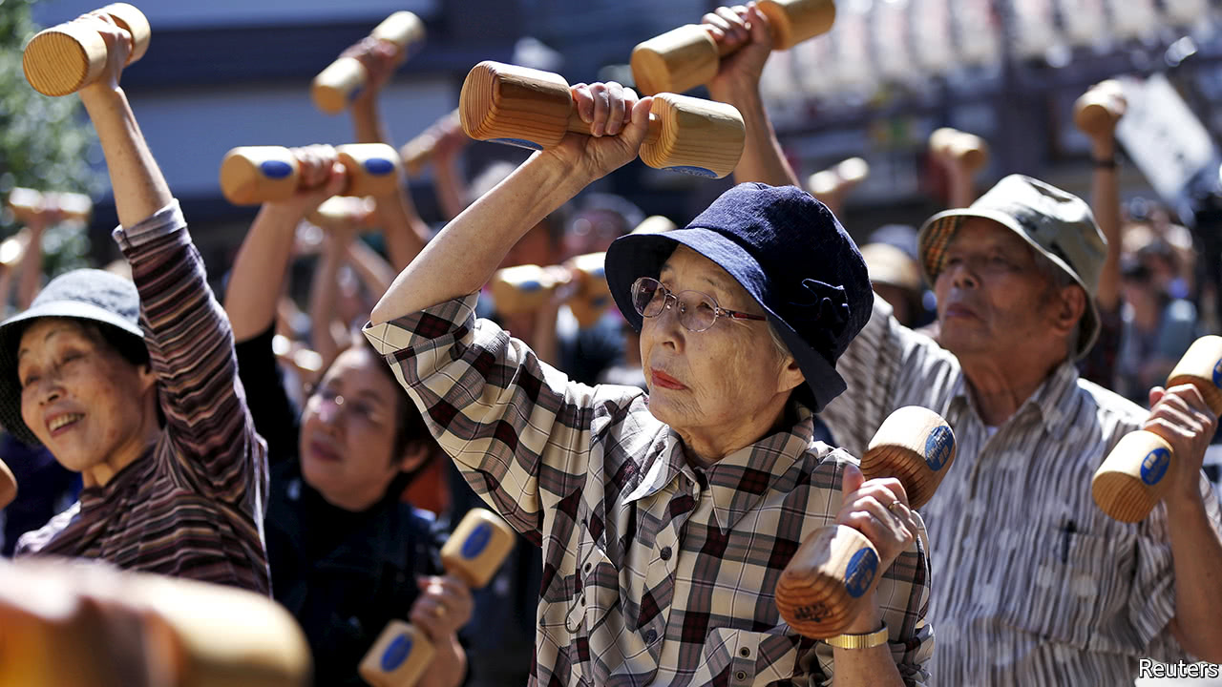
Thank You

